Slide 1
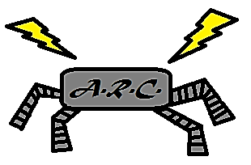


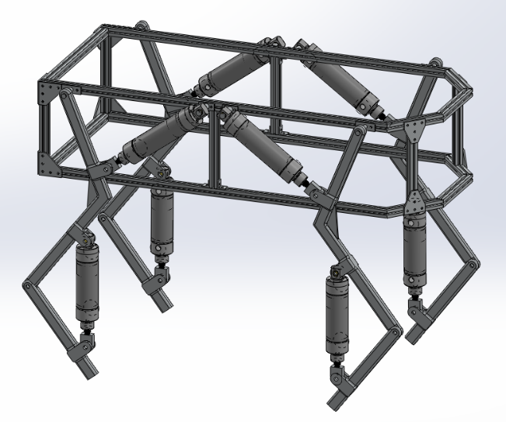
agile and educational robotics platform
Team A.R.C.
Logan Beaver
Justin Campbell
Tyler Paddock
Ron Shipman

Slide 2
Project Overview
Develop initial robotics platform
Public Outreach
Increase interest in STEM fields – 15% decrease in STEM interest in 2013
Low math and science proficiency – 65th percentile math, 50th percentile science
Fluid Power
Educational robotics platform
Fluid Power
Control Systems
Robotics

Slide 3
Major Design Decisions
Quadruped Locomotion
Agile motion
Stable
Rugged Terrain
Two Links per Leg
Pneumatic Power
High energy density
Clean and lightweight

Slide 4
Major Constraints and Objectives
Does not weight over 35 Kg
Operational speed up to 0.5 m/s
Gait implementations for creep and walk
Emergency stops easily accessible
Battery life of at least 3 hours for pneumatic components
Onboard batteries and control system
Tethered air supply

Slide 5
Dynamics And Simulations
Mathematical Notation
Free Body Diagrams
Kinematic Modelling
Dynamic Simulation
Foot force calculation

Slide 6
Mathematical notation
Consists of Body, Thigh, Shank
Angles measured relative to previous link
Leg 1 – Front Right
Leg 2 – Rear Right
Leg 3 – Front Left
Leg 4 – Rear Left
Y
Θ _{body}
Thigh
Θ _{thigh}
Shank
Θ _{shank}
Leg 4
Leg 1
Leg 3
Leg 2
X

Slide 7
Non-Inertial Reference frames
Due to robot’s acceleration the system is not in an inertial reference frame
Two solutions:
Euler-Newton: F=ma with an arbitrary ground point or virtual inertial forces
Lagrange-Euler: energy approach with generalized coordinate systems
Euler-Newton was selected due to our familiarity with it
arbitrary ground point off the robot chassis
Torque equations modified with equivalent torques to compensate

Slide 8
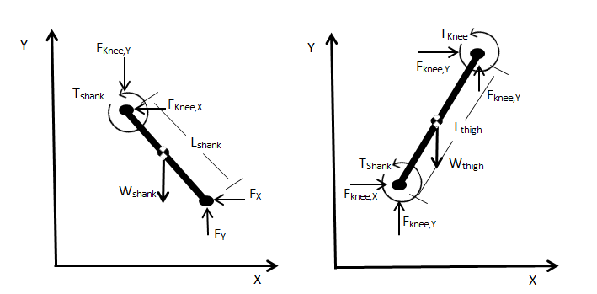
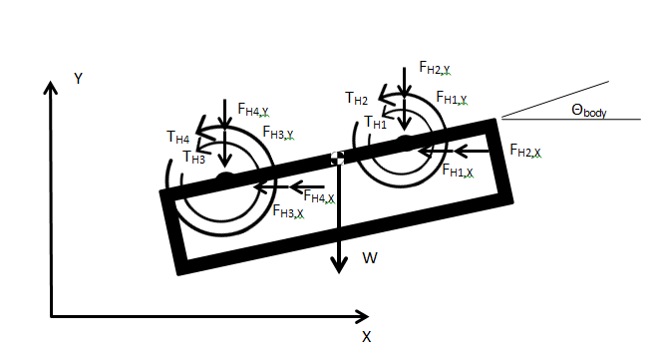
Free Body Diagrams
Used to find joint reaction forces and torques required for motion
Torque equations summed about origin
Solution assumes knowledge of kinematic state and foot forces

Slide 9
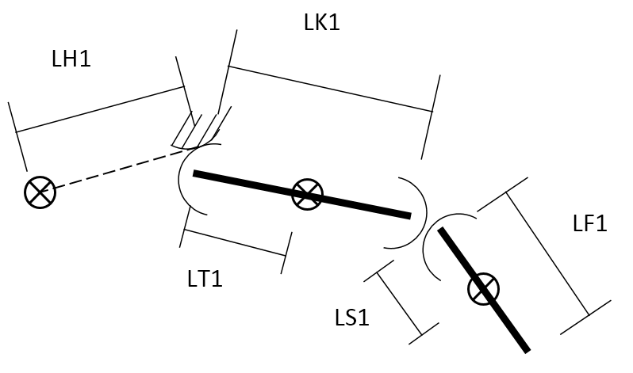
Kinematics
Four three-bar serial linkages originating at the body’s center of gravity
Body CG is at point (x, y)
16 equations to define link positions

Slide 10

Jacobian differentiation
$$\frac{df(dx_{1},dx_{2}, …,dx_{n})}{dt}=$$
= $\frac{∂f}{∂x_{1}}\frac{∂x_{1}}{∂t}+ \frac{∂f}{∂x_{2}}\frac{∂x_{2}}{∂t}+…+ \frac{∂f}{∂x_{n}}\frac{∂x_{n}}{∂t}$
$$=\left(\left[\frac{∂f}{∂x_{1}}\right]\left[\frac{∂f}{∂x_{2}}\right]\left[…\right]\left[\frac{∂f}{∂x_{n}}\right]\right)\left(\begin{aligned}\frac{∂x_{1}}{∂t} \\ \frac{∂x_{2}}{∂t} \\ ⋮ \\ \frac{∂x_{n}}{∂t}\end{aligned}\right)$$
$$=J\left(f\right)\left(\begin{aligned}\frac{∂x_{1}}{∂t} \\ \frac{∂x_{2}}{∂t} \\ ⋮ \\ \frac{∂x_{n}}{∂t}\end{aligned}\right)$$
Simplification of the Full Derivative of a multivariable function
Used to calculate velocity and acceleration of links
Break function derivative into a Jacobian and time derivative vector
Allows symbolic equation solution with MATLAB for faster iteration
Verified with hand calculations

Slide 11

State Vector
Positions, velocities, and accelerations are all in terms of a state vector, q
By extension, joint torques and forces are functions of q
$$q=\left[\begin{aligned}\begin{aligned}x \\ y \\ θ_{body} \\ θ_{hip, 1} \\ θ_{hip, 2} \\ θ_{hip, 3} \\ θ_{hip, 4}\end{aligned} \\ θ_{knee, 1} \\ θ_{knee, 2} \\ θ_{knee, 3} \\ θ_{knee, 4}\end{aligned}\right]$$

Slide 12
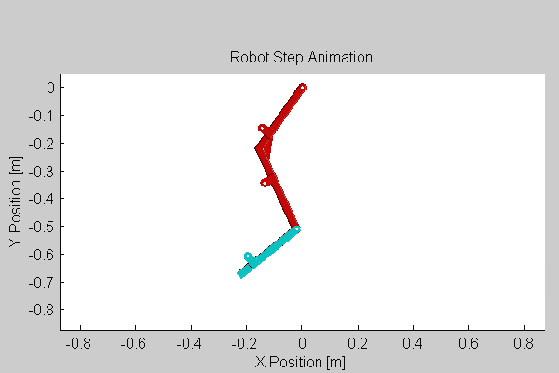
Step simulation
Kinematic simulation used to calculate joint position, velocity, and acceleration during motion
Takes foot path, step time, and dt as inputs
Outputs full joint state every time step

Slide 13
Foot force derivation
Final unknowns for torque and force calculations are the foot forces
Step split into three phases
Drag phase – Foot is pulling robot chassis while in no-slip ground contact
Swing phase – Foot is swinging through the air
Impulse phase – Foot impacts ground at the furthest forward position

Slide 14

Foot Force Derivation - Drag
Calculated using FBD of full robot
Assuming some constant forward velocity
Assuming no slip between pulling foot and ground
Coefficient of friction 0.5
Robot weight split evenly between legs
$$F_{F1y}=F_{F2y}=F_{F3y}=F_{F4y}=\frac{w}{4}$$
$$F_{F1x}=F_{F2x}+F_{F3x}+F_{F4x}=\frac{3w}{4}μ$$
Y
w
FF3X
FF3X
FF3X
FF4Y
FF1X
FF3Y
FF2Y
FF1Y
X

Slide 15

Foot Force Derivation - Swing
Calculated using FBD of full robot
No forces acting on swinging foot
Weight evenly distributed on other feet
X direction foot forces approximately zero
$$F_{F2y}=F_{F3y}=F_{F4y}=\frac{w}{3}$$
Y
w
FF4Y
FF3Y
FF2Y
X

Slide 16

Foot Force Derivation - Impulse
Calculated using conservation of momentum on leg
Assuming impulse force is constant
Assuming other leg forces are unchanged from the swing phase
$$m_{shank,1}v_{shank,1}+m_{thigh,1}v_{thigh,1}=\int_{0^{−}}^{0^{+}}{f\left(t\right)dt}=f(0)$$
Y
w
FF4Y
FF1X
FF3Y
FF2Y
FF1Y
X

Slide 17
Results
Torques and forces used for finite element analysis of structural elements
Torques used with motion study to determine cylinder stroke, bore size, and maximum pressure
Cylinder analysis used to create specifications for other pneumatic components, such as storage tanks and tubing/valve size

Slide 18
Mechanical Design
Component Design
Chassis
Thigh
Shank
FEA of Components

Slide 19
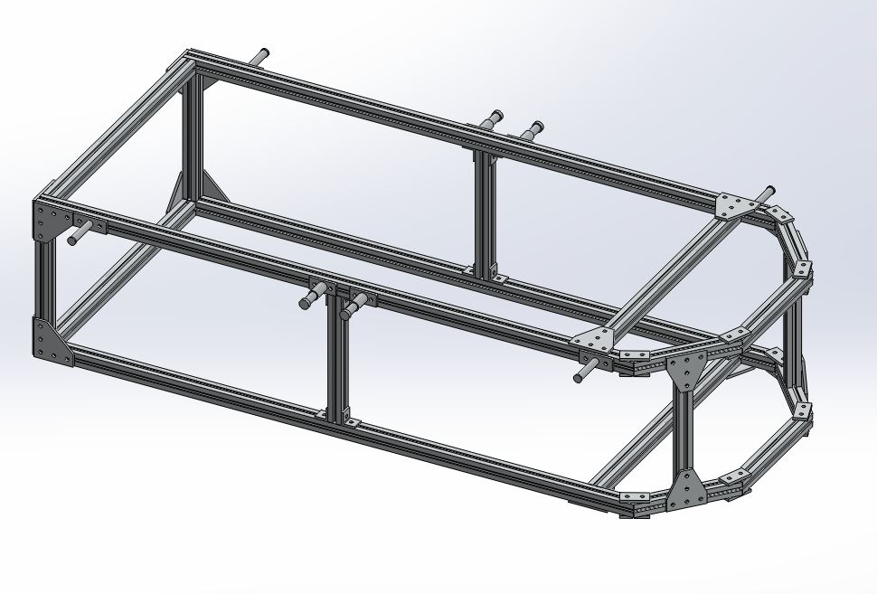
Chassis
Main support for the body
Houses all electric and pneumatic components
Needs to allow easy access to components
Provide protection from falls/collisions
Lightweight design to reduce the overall forces on the legs

Slide 20
Chassis Construction
6105-T5 T-Slotted Aluminum framing
Strong, lightweight material
Yield Strength = 275 MPa, Ultimate Strength = 310 MPa
Variety of plates/brackets available for easy assembly
Lengths will be cut and assembled using available plates
Addition of cross brace to reduce stress near front legs
Hip and Piston joint will be fashioned with similar attachments as plates

Slide 21
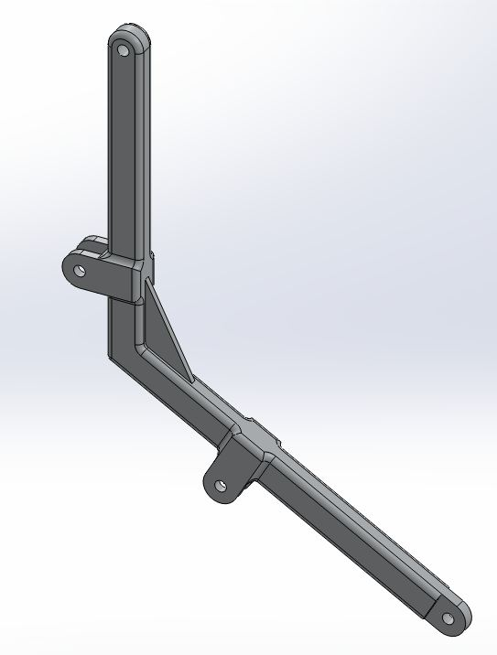
Thigh
Based on the leg structure of quadruped mammals
Removal of 3rd joint for simplification of design
Bent thigh to compensate for lost mobility
Prevents singularity point of knee piston
Rib added at bend to reduce stress felt by joint

Slide 22
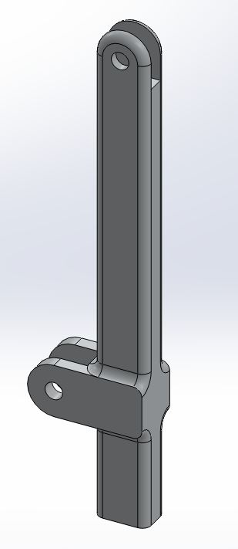
Shank
Portion of leg that will contact the floor
Length determined by step length
The end of the shank will be dipped in Urethane

Slide 23
Thigh/Shank Construction
6061 Aluminum Bars
Good strength, machinability, and easily welded
Yield Strength = 276 MPa, Ultimate Strength = 310 MPa
Thigh bend will be welded

Slide 24
Finite Element Analysis of Components
All components tested using “worst case” scenario
Moving at top speed
Creep gait being used
Hip and Knee joint seized
Mesh
Surface mesh sufficient
Kept Quad8 elements to accurately track bending
Average Mesh quality around 0.75 for all components

Slide 25
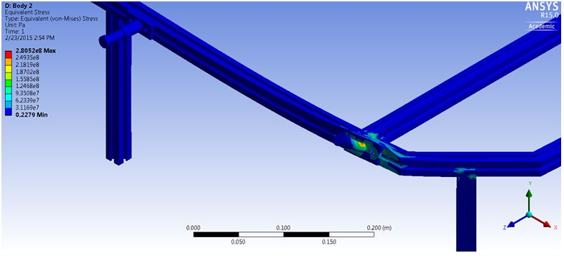
Chassis FEA Result

Slide 26
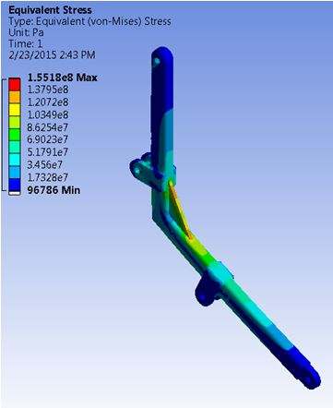
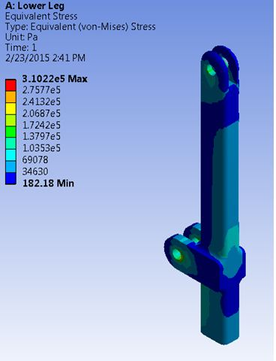
Thigh/Shank FEA result

Slide 27
Power Source
Power source options
Component specifications
-Air Cylinders
-Directional Control Valves
-Air Compressors
Other circuit components

Slide 28
Power Source Options
 | Advantages | Disadvantages
Hydraulic Power Source | -Highest achievable power density | -High maintenance -Heavy -Dirty
Electric Power Source | -Accurate positioning | -Lowest achievable power density -Noncompliant
Pneumatic Power Source | -Higher power density than electric power -Low Maintenance -Compliant action from fluid compression | -Compressible fluid causes inaccuracy in positioning

Slide 29
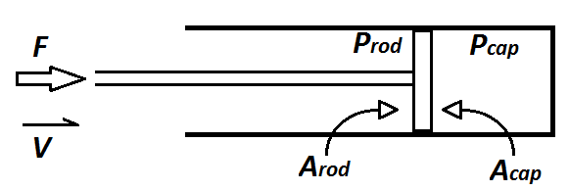

Air Cylinders
Converts fluid power into mechanical power
Position Feedback Sensor (PFS)
Dual-acting
Specifications limited by:
-Volume available for cylinder placement
-Necessary pressure
-Necessary volumetric flow rate
$$F =P_{cap}A_{cap} −P_{rod}A_{rod}$$

Slide 30

Example Specification process
Required Cylinder Specs:
178 lb_{f} max output
4 inch stroke length
60 cycles per minute
Extend phase:
$P=\frac{F}{A_{cap}}= \frac{178 {lb}_{f}}{3.1416 {in}^{2}}=56.66 psi$
Retract Phase:
$P=\frac{F}{A_{cap}−A_{rod}}= \frac{178 {lb}_{f}}{3.1416 {in}^{2} −0.196{ in}^{2}}=56.8 psi$
Total Volumetric Flow:
$Q={(A}_{piston}{)(D}_{Total})(N)(Compression Ratio)$
$$Q=\frac{\left(3.1416 {in}^{2}\right)\left(8 in\right)\left(60\right)\left(\frac{56.73psi+14.7psi}{14.7psi}\right)}{\left(1728\frac{in^{3}}{ft^{3}}\right)}$$
$Q=4.24 \frac{{ft}^{3}}{min}$ at STP
Selected Cylinder Spec:
2 inch bore diameter

Slide 31
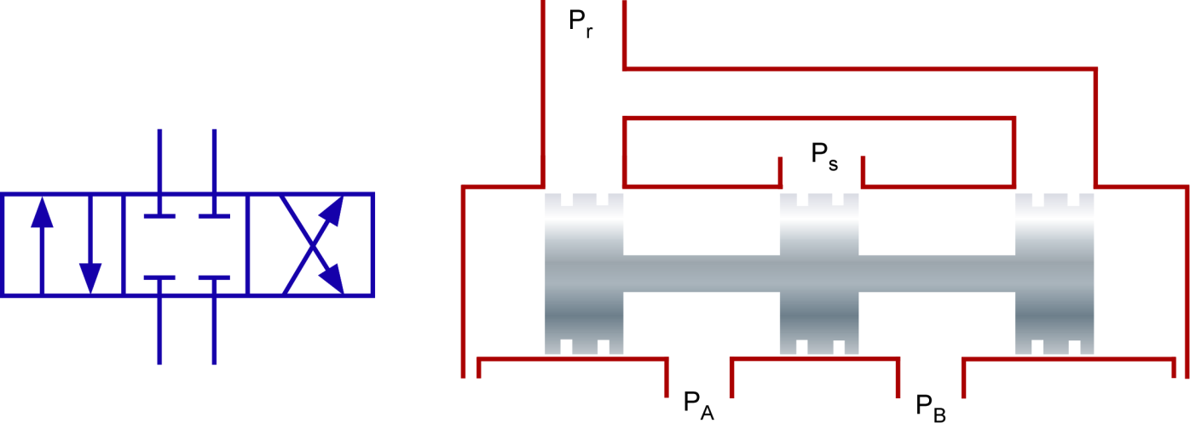

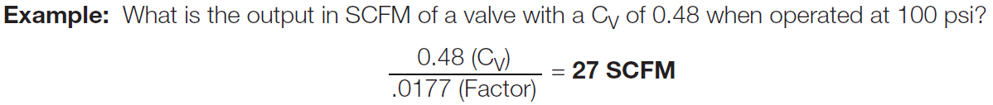
Directional Control Valves (DCV)
Controls fluid flow into air cylinders based on spool position
4-3 DCV
Specifications determined by:
-Necessary volumetric flow rate to air cylinder

Slide 32
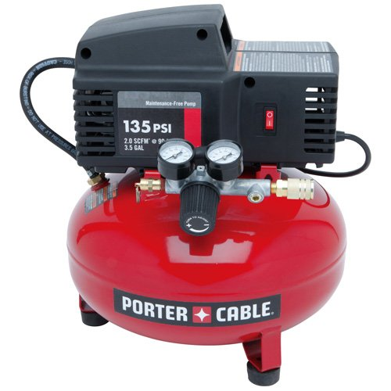
Air Compressor
Compresses air absorbed from
surrounding environment
Feeds to components downstream
Specifications determined by:
-Maximum pressure required by air cylinders
-Average volumetric flow rate required by air cylinders

Slide 33
Selected Specifications
Air Cylinders w/ PFS (8): 2 inch bore diameter, 3 inch stroke length for shank, 4 inch stroke length for thigh
Directional Control Valves (8): 4 ports, 3 spool positions, C_{v} = 0.67 (21 CFM)
Air Compressor: 10 gallon, 5.3 CFM (At 90 psi), 125 psi maximum pressure

Slide 34
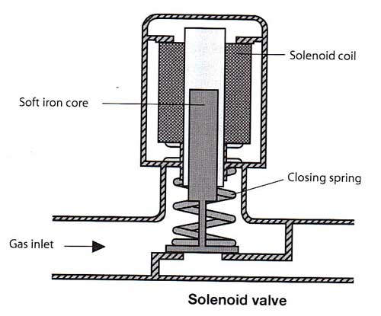
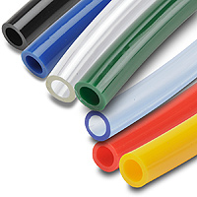
Remaining Pneumatic components include:
Receiver Tank
-Sized depending on additional flow needs
Solenoid Valve
-Main on/off switch of fluid flow to system
Pressure Relief Valve
-Dictates maximum system pressure
Tubing

Slide 35
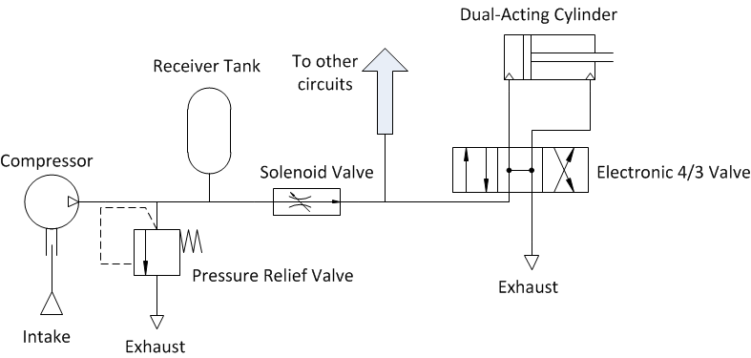
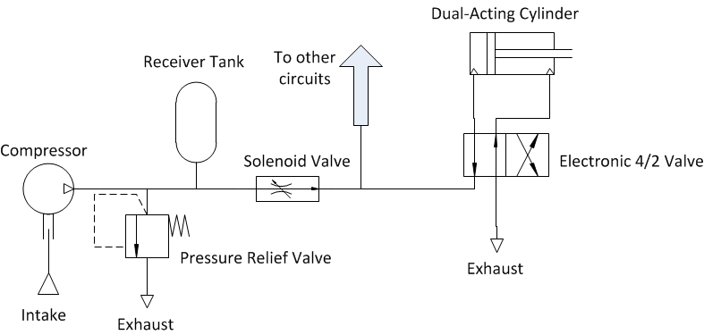
Pneumatic Circuit Segment

Slide 36
Electrical
Microcontroller and Programming
Control Algorithms
Communication System
Debug Panel
Control Signal and Feedback Conditioning

Slide 37
Microcontroller and Programming
Arduino Mega 2560 is used to control the system’s actions
Advantages
-Low cost microcontroller
-Analog inputs
-Pulse-width modulated outputs
Mathwork’s Simulink models cross compiled to microcontroller

Slide 38
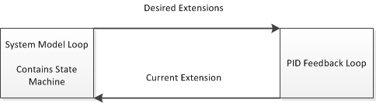
Control Algorithms
The Simulink PID algorithms are used for control
Implementation of a step is done using state machine architecture
The state machine drives the PID in each control loop

Slide 39
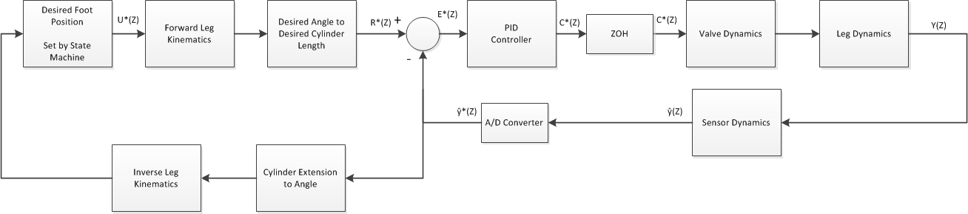
Control Algorithm For One Leg

Slide 40
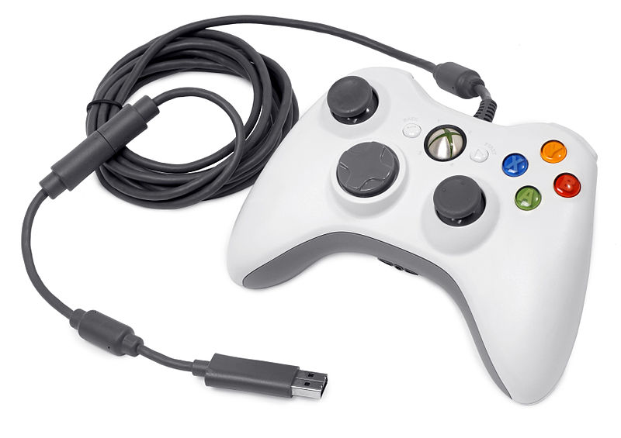
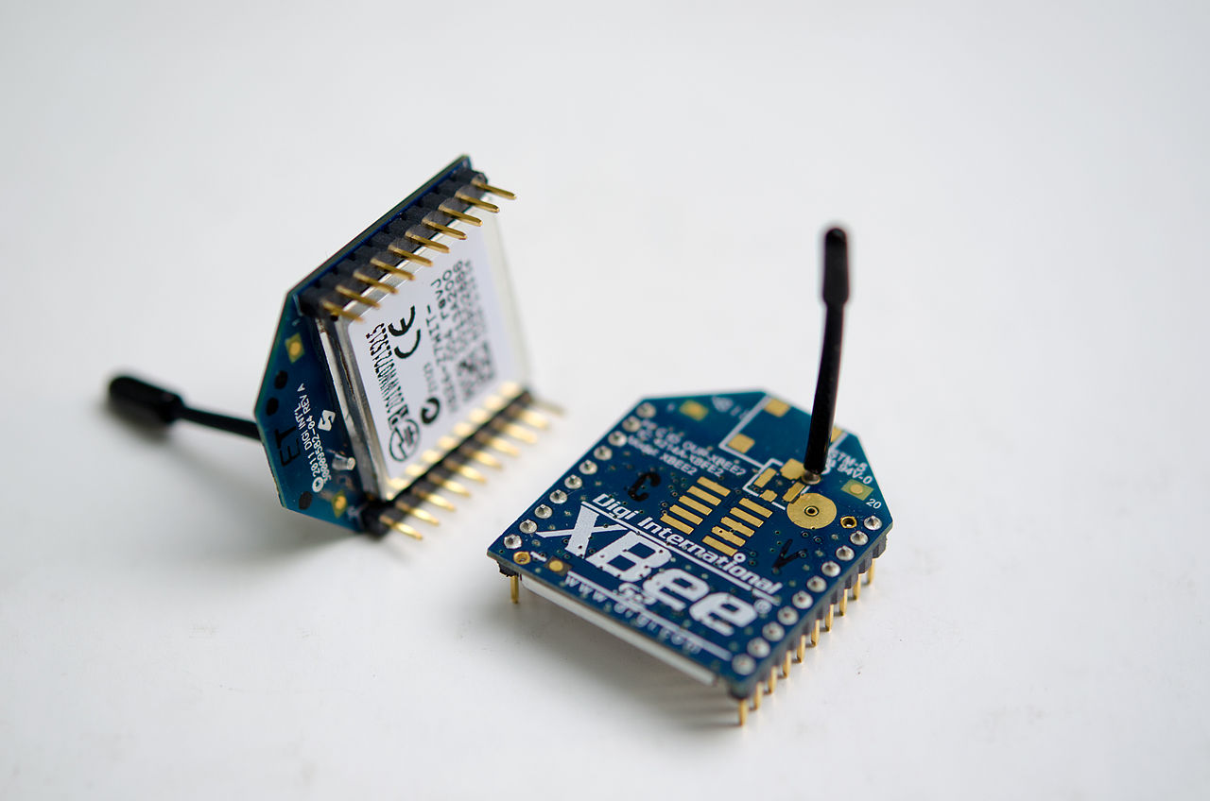
Communication System
XBee Series 1 Radio
-IEEE 802.15.4 protocol
-Operational Frequency 2.4 GHz
Mounted onto the Arduino through XBee Shield
User interface runs on PC Simulink model

Slide 41
Debug Panel
Standard for MSOE test equipment – Banana Plug
On Switch
Emergency Stop – Cuts Power to valve solenoids
Battery Level Indicators
Status LEDs

Slide 42
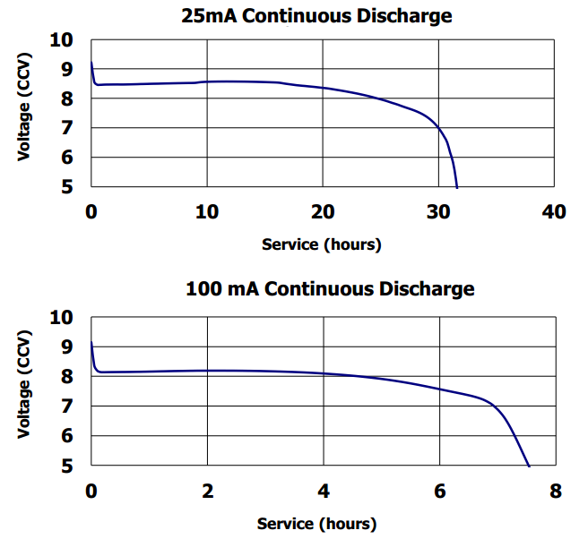
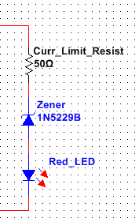
Debug Panel – 9 volt battery Indicator
Three LEDs in series with zener diodes
LED colors: Green, Yellow, Red

Slide 43
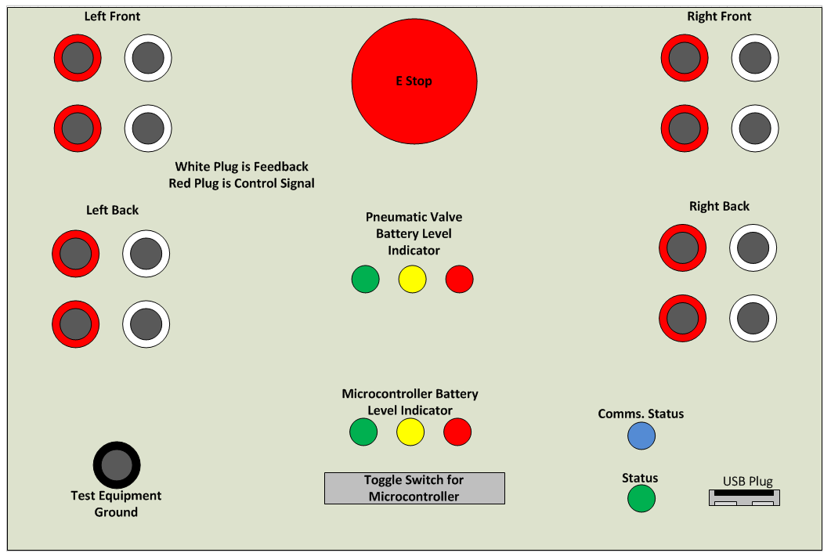
Debug Panel Diagram

Slide 44
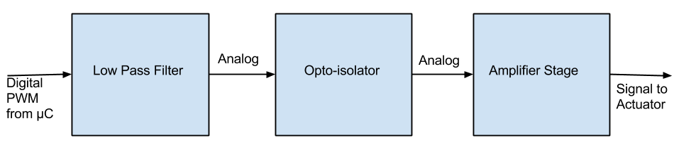
Control Signal and Feedback Conditioning
Signal Conditioning
PWM -> analog voltage -> optical signal -> analog voltage
Opto-isolator separates electrical circuits

Slide 45
What’s Next?
Finalize component specifications
Order subsystem components
Control system development
Build prototype leg and test control
Assemble chassis and electrical systems
Gait implementation

Slide 46
Questions?

